Slide 1

Software Engineering (SE)
# 2101CS503
Lab -5 Data Flow Diagram
Prof. Ekta A. Baldha
Computer Science & Engineering Department
Ekta.baldha@darshan.ac.in
+91-7984243066

Slide 2
Data flow diagram
A data flow diagram (DFD) is a graphical representation of the "flow of data” through an information system.
It includes data inputs and outputs, data stores, and the various sub processes, the data moves through.
Before actually creating your data flow diagram, you’ll need to determine whether a physical or logical DFD best suits your needs.

Slide 3


Symbols and Notations Used in DFD
External Entity
Entity is an outside system that sends or receives data, communicating with the system being diagrammed. They are the sources and destinations of information entering or leaving the system.
External Entity
External Entity
Yourdon and Coad Notation
Gane and Sarson Notation
Data Store
A data store does not generate any operations but simply holds data for later access. Data stores could consist of files held long term or a batch of documents stored briefly while they wait to be processed.
Data Store
Data Store
Yourdon and Coad Notation
Gane and Sarson Notation

Slide 4

Symbols and Notations Used in DFD
Process
An activity that changes or transforms data flows. Since they transform incoming data to outgoing data, all processes must have inputs and outputs on a DFD.
Process
Process
Yourdon and Coad Notation
Gane and Sarson Notation
Data Flow
Movement of data between external entities, processes and data stores is represented with an arrow symbol, which indicates the direction of flow.

Slide 5
Rules for designing DFD
No process can have only output or only input. The process must have both input and output.

Slide 6
Rules for designing DFD
There should not be a direct flow between data stored and external entity. The flow should be go through a process.

Slide 7
Rules for designing DFD
No data should move directly between external entities. The data flow should go through a process.

Slide 8
Logical data flow diagram
Physical data flow diagram
Logical data flow diagrams focus on what happens in a particular information flow
What information is being transmitted, what entities are receiving that info, what general processes occur.
The processes described in a logical DFD are business activities, A logical DFD doesn’t delve into the technical aspects of a process or system.
Non-technical employees should be able to understand these diagrams.
Physical data flow diagrams focus on how things happen in an information flow.
Physical DFD specify the software, hardware, files, and people involved in an information flow.
A detailed physical data flow diagram can facilitate the development of the code needed to implement a data system.

Slide 9
Example of physical data flow diagram
Assume the process of cash deposit in bank
1.0
Clerk takes money
Customer
Give Cash
Cash and
register tape
2.0
Cashier accept money
Deposit slip
and cash
Bank

Slide 10
Example of logical data flow diagram
Assume the process of cash deposit in bank
1.0
prepare deposit tape
Customer
Payment
Receipt summary
2.0
Compare cash and tape
Validate receipt
3.0
Prepare deposit
Deposit receipt
Bank

Slide 11
DFD Level-0 (Context Diagram) For LMS
Assume all process of library.
Request for book
Member
Issue book
Library Management System
Request for generating report
Return book
Search book
Issue and return
book report generated
Result of searching book
Library Staff
Manage member account
Manage book database

Slide 12
Data flow diagram levels
Data flow diagrams are also categorized by level. Starting with the most basic, level 0, DFDs get increasingly complex as the level increases.
Level 0 DFDs, also known as context diagrams. It provides a basic overview of the whole system.
It shows the system as a single high-level process, with its relationship to external entities.
DFD Level 1 provides a more detailed breakout of pieces of the Context Level Diagram.
You will highlight the main functions carried out by the system, as you break down the high-level process of the Context Diagram into its sub processes.

Slide 13
DFD Level-1 For LMS
Book request
1.0
Issue book
Library card
Book detail
Member
Book
Book master
Book detail
2.0
Return book
Book detail
Search query by title
List of titles
3.0
Search book
Booklist according to title
Book request by name
Result by book name
Booklist according
to author-name
Search query by author name
List of author

Slide 14
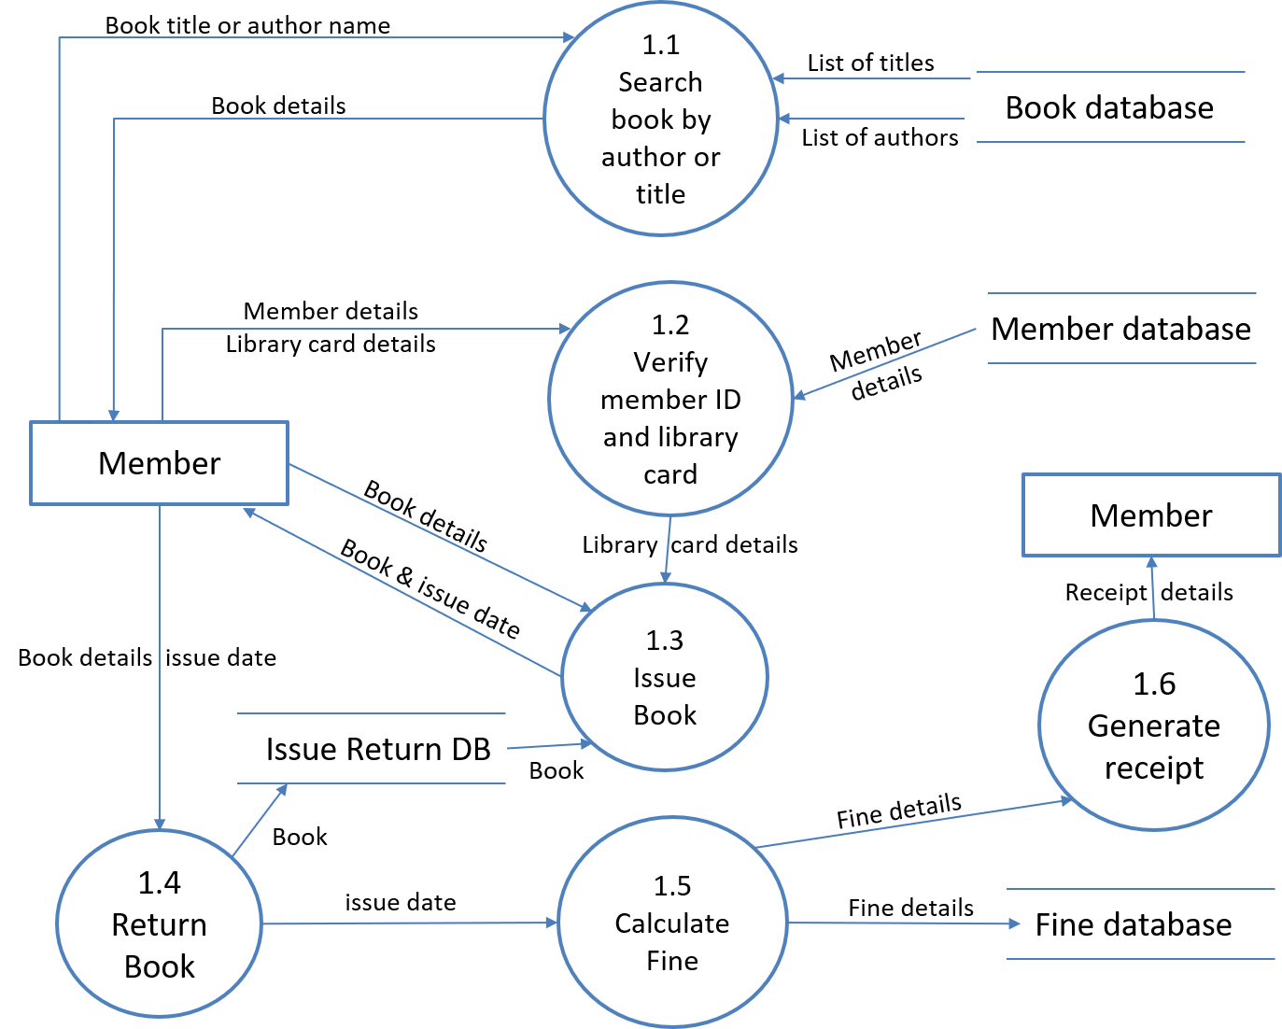
DFD Level-2 For LMS

Slide 15

Software Engineering (SE)
# 2101CS503
Prof. Ekta A. Baldha
Computer science & Engineering Department
Ekta.baldha@darshan.ac.in
+91-7984243066

